Slide 1
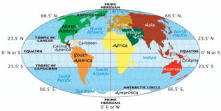
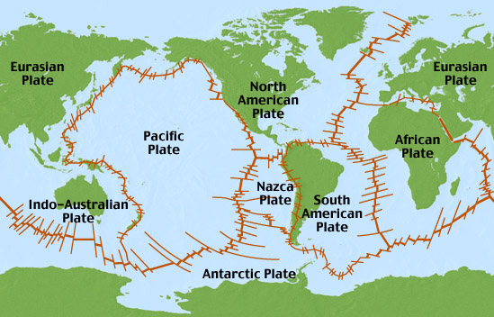
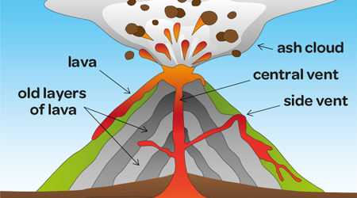
Our Changing Earth
Year 6 Spring Term.
There are 7 continents on Earth: Asia, Africa, North and South America, Antarctica, Europe and Australasia.
A country’s physical geography –
where it is in the world geographically - determines its climate; its vegetation; its types of settlements; its land use and its economic activity.
The Equator is an imaginary circle around Earth. It divides Earth into two equal parts: the Northern Hemisphere and the Southern Hemisphere. The distance around the Equator is about 24,900 miles (40,000 kilometres). The Equator appears on maps and globes.
Volcanoes are formed when magma at the centre of the Earth pushes its way upwards through the Earth through a long shaft. When the magma travels through the Earth's crust and reaches the Earth's surface, it cools and hardens into a pile of rock. Many volcanoes are mountains as a result of this process.
Earthquakes happen when two large pieces of the Earth's crust suddenly slip. This causes shock waves to shake the surface of the Earth in the form of an earthquake. Where do earthquakes happen? Earthquakes usually occur on the edges of large sections of the Earth's crust called tectonic plates.
There are about 20 known super volcanoes on Earth - including Lake Toba in Indonesia, Lake Taupo in New Zealand, and the somewhat smaller Phlegraean Fields near Naples, Italy. Super-eruptions occur rarely - only once every 100,000 years on average.

Slide 2
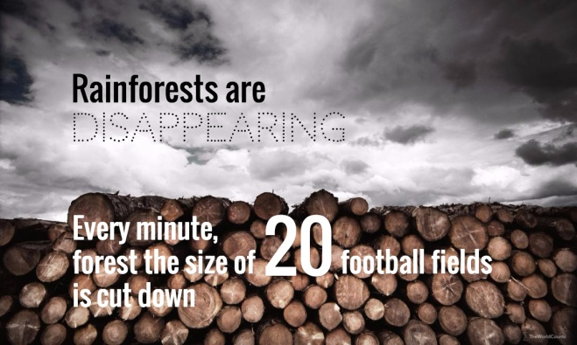
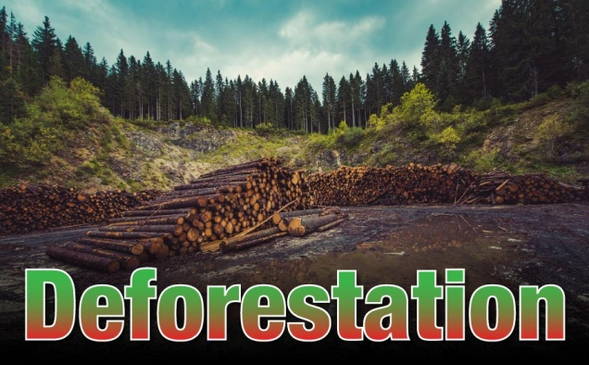
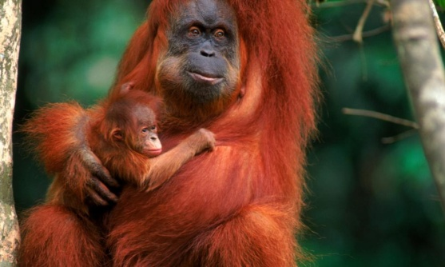
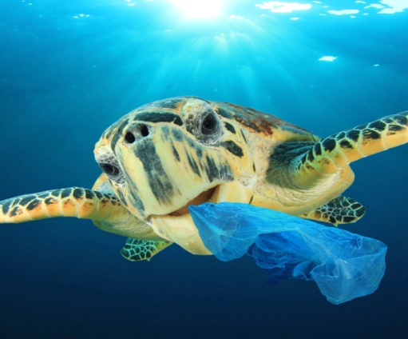
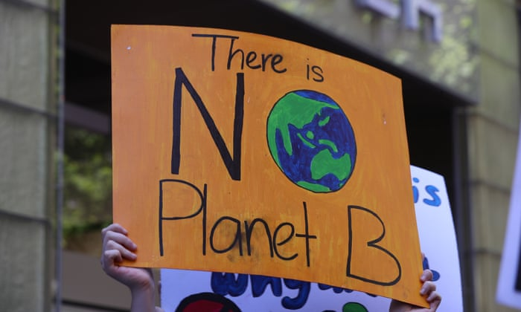
Deforestation is when forests are destroyed by cutting trees (logging) and not replanting them. Sometimes deforestation happens when people change lands into farms, ranches and cities. The most common cause for deforestation is obtaining wood and fuel. This destroys the habitat of many animals, leading to their death.
When these forests are cut down, the plants and animals that live in the forests are destroyed, and some species are at risk of being made extinct.
We need the rain forests to produce oxygen and clean the atmosphere to help us breathe. We also know that the earth's climate can be affected, as well as the water cycle.
Important Vocabulary
Plastic pollution is the accumulation of plastic objects and particles (e.g.: plastic bottles and much more) in the Earth's environment that adversely affects wildlife, wildlife habitat, and humans.
Continents | Latitude | Tectonic Plates | Earthquake
Biomes | Longitude | Volcanoes | Lava
Climate zones | Crust | Eruption | Volcanic Ash
Tropics | Mantle | Active | Plate Boundary
Equator | Outer Core | Dormant | Epicentre
Northern Hemisphere | Inner Core | Extinct | Tremors
Southern Hemisphere | Magma | Tsunami | Plastic Pollution
Deforestation | Climate Change | Vegetation belts | Biodegradable

