Slide 1
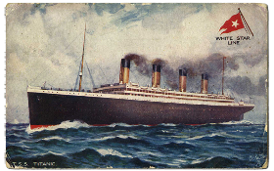
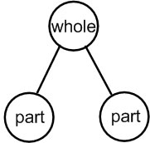
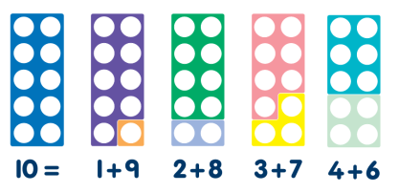

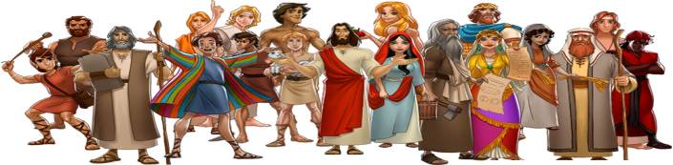
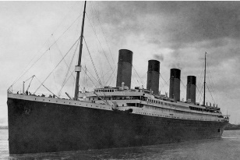
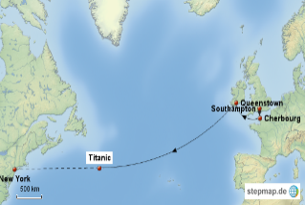
Welcome to Year 2!
This term in Year 2 we will be learning…….
English
Maths
We will be developing our understanding of how to write recounts, stories and poetry this term.
We will be writing different styles of recounts all linked to our learning about the Titanic. This will develop our understanding of how to write about real life events in interesting ways.
We will spend the first half of this term focusing mostly on place value and ordering and comparing 2 digit numbers. We will use our knowledge to represent numbers in different ways, solve problems involving 2 digit numbers and develop our
Understanding of addition.
We will be consolidating our
knowledge of 2d shapes and
Develop our understanding of
the properties shapes.
Our story writing will be linked to the Titanic. We will be using the story to develop our vocabulary, familiarise ourselves with story structure and learn new sentence types to make our own writing exciting before writing our own versions of the story.
After half term we will be further applying our knowledge of 2 digit numbers to develop our understanding of
After half term we will be learning about different types of poetry and writing our own.
subtraction. To support your child’s maths learning at home please help them to develop their rapid recall of key maths facts, such as number bonds to ten and the multiplication and division facts for the 2X table.
Religious Education
Our Topic –
Terrific Titanic
Our first R.E topic this half term is studying the Old Testament. We will be learning about some of people who feature in the Old Testament stories and why they are important to us today. We will also be learning how we are all called to be like these people by following God. You could read and share some of the fantastic stories from the Old Testament to your child to help deepen their understanding.
This term we will be learning all about RMS Titanic and its fateful maiden voyage.
We will learn about where the ship was built, what is looked like both inside and out and the
Experiences of the passengers on board. We will also learn about what happened to the Titanic during its first voyage to New York and how this
disaster changed ocean travel for the future.

Slide 2
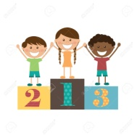

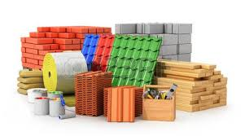

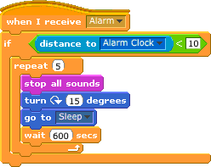

Science
P.E. lessons with Mr Bromley will take place each Tuesday and Thursday afternoons.
P.E.
This term in Science we will be learning about the different properties and purposes of materials. We will be investigating the best waterproof materials and the materials that float.
We will also learn about different Scientists and Inventors and how they have changed the world because of their ingenious ideas and developments.
This term the children will be developing their basic ball skills.
Computing
Over the course of the term we will be learning how to write our own programmes to create short games and to move floor turtles. We will also be developing our understanding of how to keep ourselves safe when using the internet and our own digital devices.
Things to remember
Times Tables
Mrs Edwards teaches Monday-Wednesday and Mrs Speller teaches Thursday-Friday.
Mrs Gregg supports our learning everyday.
Reading each night, sharing a story and talking about what you have read.
P.E. kit required every Tuesday and Thursday
Named water bottle in school every day.
Practise rapid recall of maths facts such as number bonds to ten and multiplication and division facts for 2 and 10 times table.
In Year 2 we have a weekly, voluntary contribution from parents of £1. This makes a huge difference in our ability to provide the children with additional resources and experiences. Please hand this in each Monday.
It is important that the children begin to develop the ability to recall times tables facts. This term we are focusing on learning the 2x and 10x table. They need to be able to know the multiplication fact (2 X3 = 6) and also the matching division fact ( 6 divided by 2 = 3 and 6 divided by 3 is 2). There are many games, songs and apps that you can use to support your child’s learning.
Reading
All children are expected to read at home every night and discuss what they have read with an adult. This doesn’t have to be their School reading book as this can become quite dull! Please take opportunities across the week to read different genres of books to expand their knowledge of different text types and authors. It is essential that your child fully understands the text they are reading and becomes familiar with new vocabulary. Please also try and read to your child as often as possible as this helps to develop their vocabulary, understanding of different stories, text types and helps to instil a love of reading. This is vital for children to progress across the whole curriculum.
How Can we Help at Home?
Use the internet or visit the library to research our Titanic topic.
Share a book together regularly and talk about what you have read.
Read a range of different types of books as often as you can to expand vocabulary and understanding of different types of text.
Practise multiplication and division facts regularly and at speed at home
Questions…?
Should you have any worries, questions or concerns, please feel free to come and see us (at the end of the School day is usually the best time)
Kind regards
Mrs Edwards & Mrs Speller

