Slide 1




Welcome to Reception Class
2024 - 2025

Slide 2





Welcome
A very warm welcome for you and your child to St Anthony’s Catholic Primary School!

Slide 3
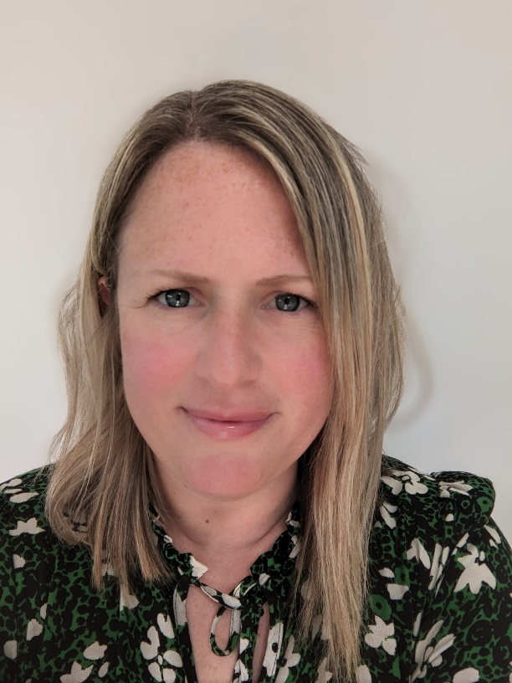
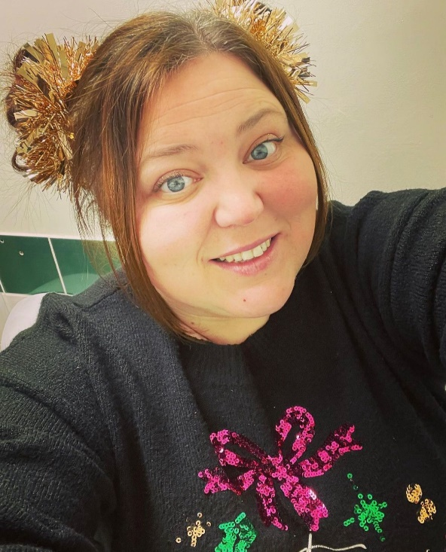

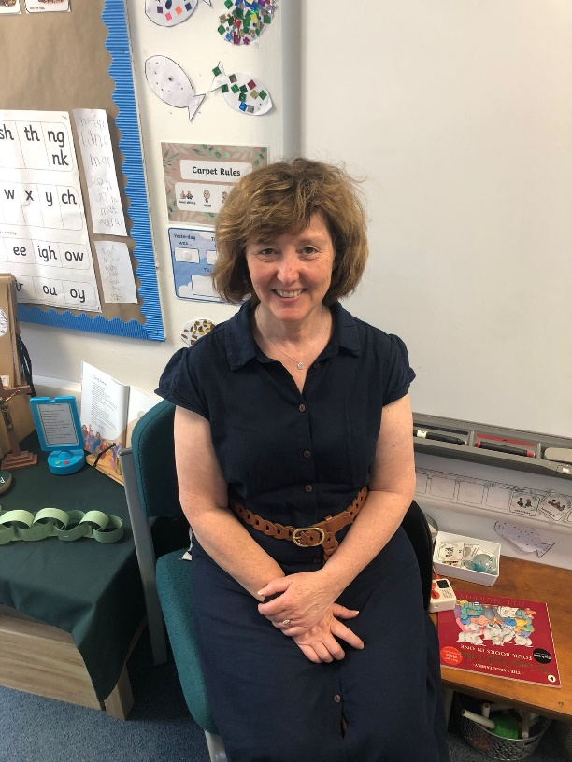
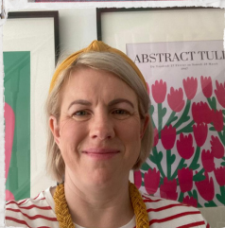

The team
Mrs Shepherd
Miss Richardson
Class Teacher
Monday- Thursday
Learning Assistant
Thursday and Friday
Miss Larkin
Mrs Slater
Class Teacher
Friday
Learning Assistant
Monday - Wednesday

Slide 4

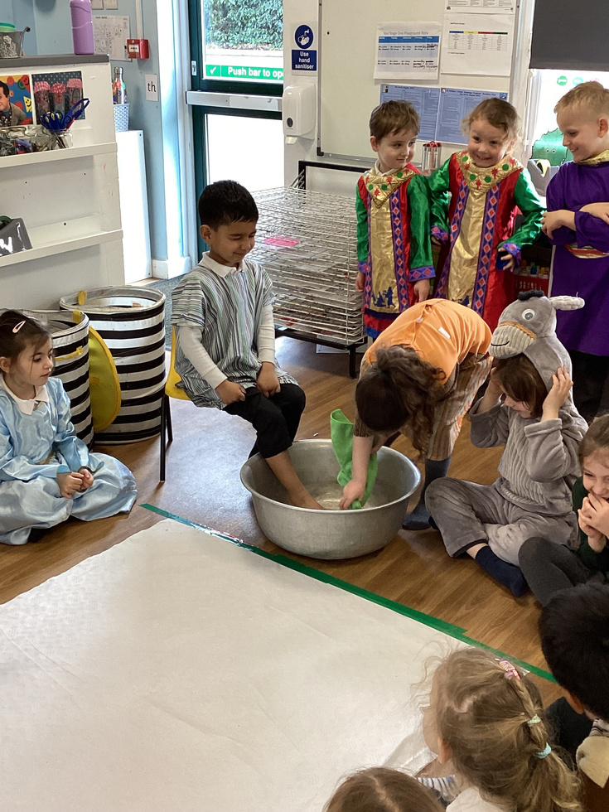

Our Catholic School
Our Catholic Faith is at the heart of our curriculum provision and ethos of our school. Our school mission is;
By following the example that Christ set for us, we aim to foster a love of learning, enquiry and truth, developing respect for others and a tolerance of personal differences.
We walk in the footsteps of Christ and are held in the hand of God.
In addition to our Gospel values, we ensure that each and every member of our school community is nurtured as children of God to strive for excellence in all that they do, guided by the Jesuit Values and Virtues.

Slide 5

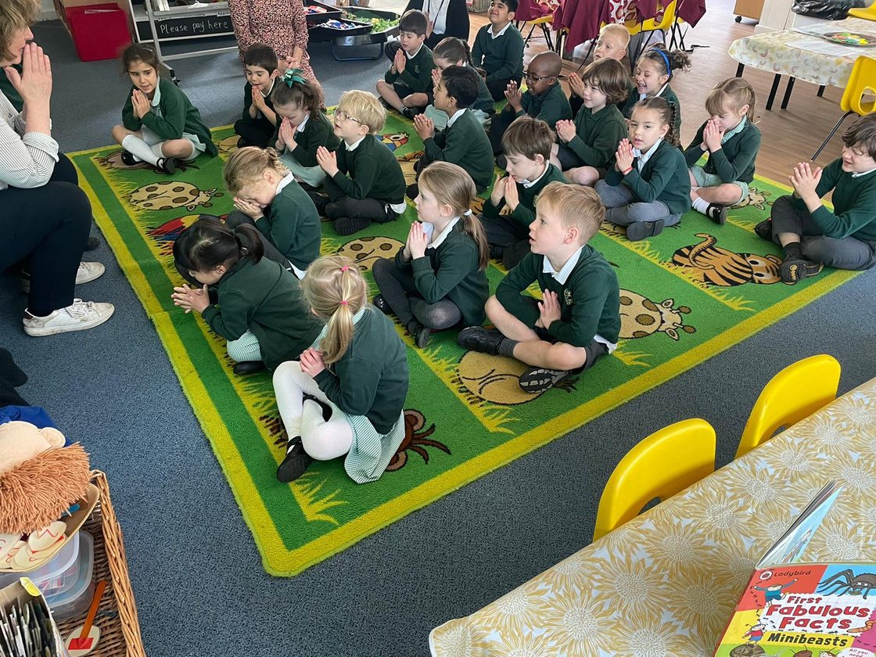

Our Catholic Life
Throughout the school we pray together at key moments during the day. We gather together in Worship for school assemblies and celebrate Mass together.
In our learning, we grow our faith by listening to stories, creating art work, writing our own prayers, role playing, singing and listening to music.

Slide 6


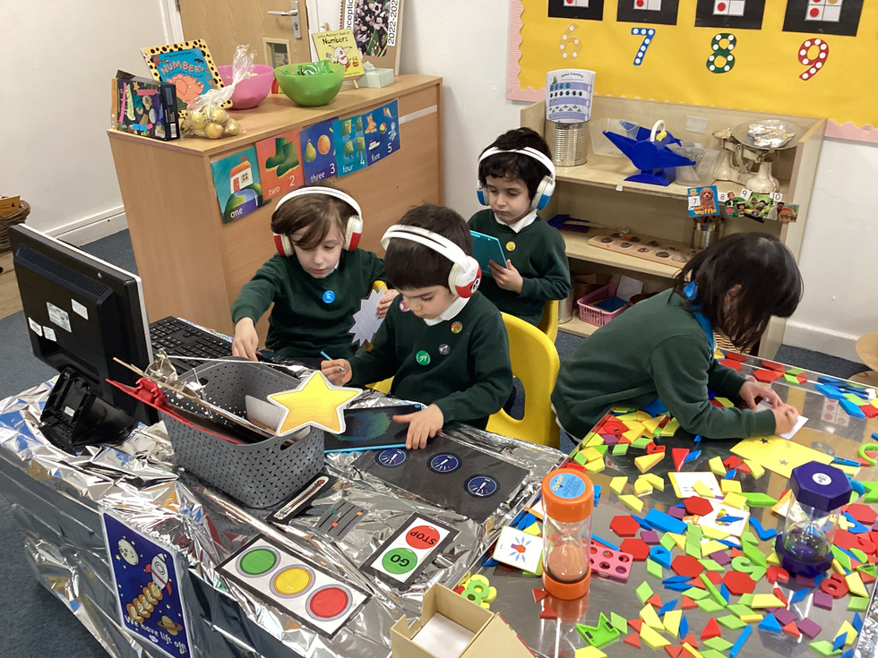

Our learning environment
The Statutory Framework for the Early Years Foundation Stage explains that;
“Play is essential for children's development, building their confidence as they learn to explore, relate to others, set their own goals and solve problems. Children learn by leading their own play, and taking part in play which is guided by adults.”
Therefore, as professional practitioners, we are constantly adapting and developing their learning environment to meet the needs of all of our children.

Slide 7

Sharing our learning
Class Dojo is an educational communication platform we use in school to reward behaviour choices and share our learning on our class feed with parents.
We will send you an email with an invitation to our class page in the coming weeks. Please download the app and accept this at your earliest convenience so that we can begin sharing your child's school experiences with you.
We are only able to set up one account per family, so please let us know which email address you would prefer us to use.
We share learning and experiences through class dojo, this is a snap shot of their learning and is there to provide a conversation starter.

Slide 8
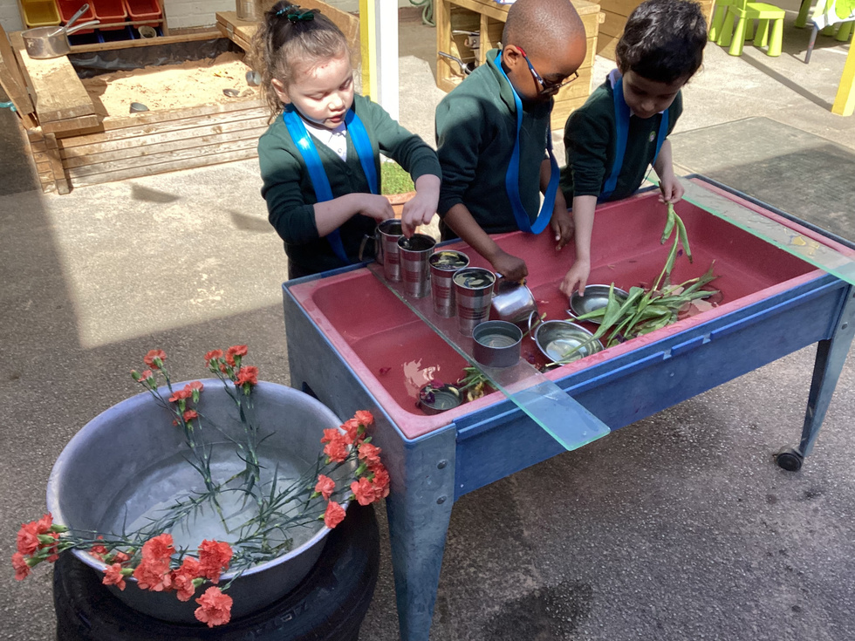
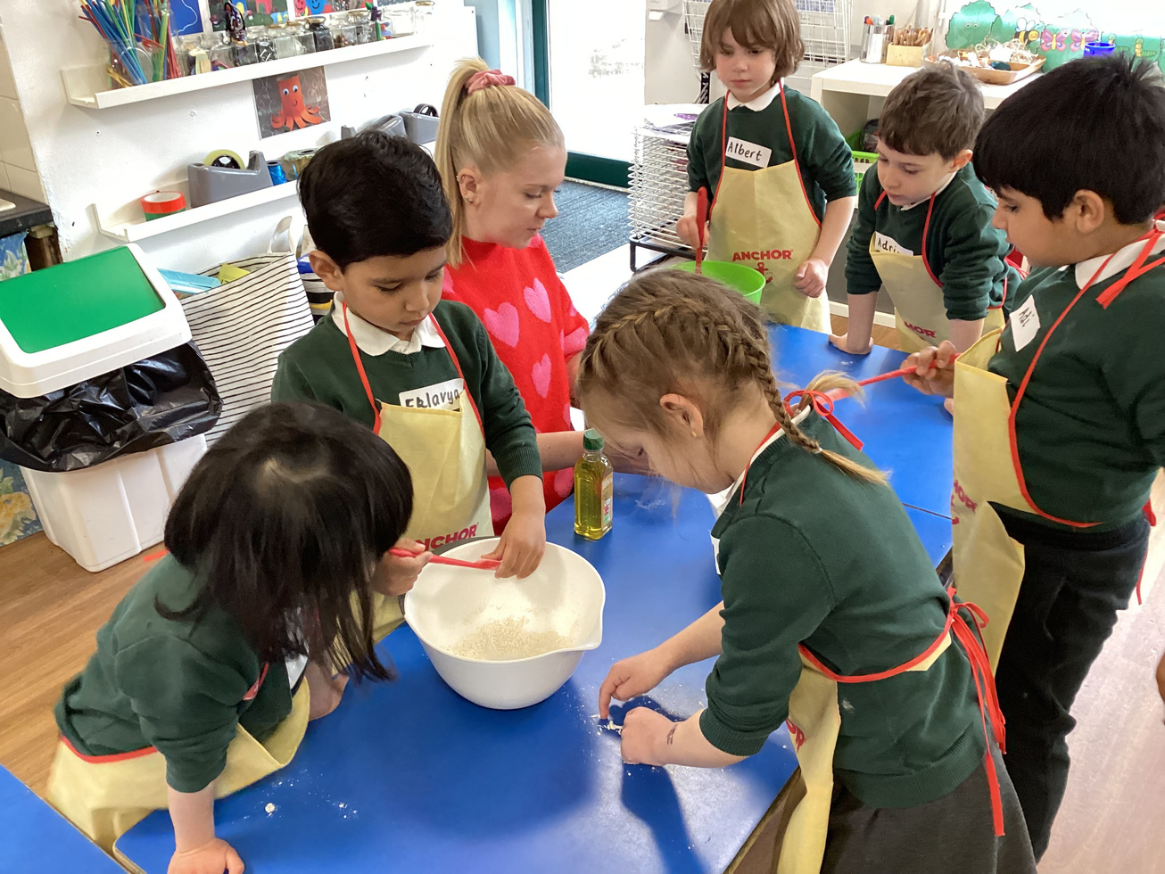
Class Fund
Each class in St Anthony’s has a Class Fund which parents kindly donate towards.
As mentioned, learning in the Early Years Foundation Stage is creative, imaginative and play based, each week in Reception Class we use many items in our activities which have to be replaced regularly, such as cooking ingredients, craft materials and other resources.
To help fund this, we ask that parents make a voluntary contribution of £2.00 per week.
We also have a Wishlist on Amazon of much needed resources which is regularly updated. By following the link on our class page of the school website, you can choose and purchase the resources you wish to gift to our Class, any of which will be gratefully received.

Slide 9
Our School day
The school day starts promptly 9:00am and finishes at 3:30pm.
Please make sure that your child arrives on time and is collected on time at the end of the day.
When you bring your child in the morning, you should come round to the Key Stage 1 Playground, where we will meet them.
At the end of the day, you can collect them from the Reception class door. Your child will only be allowed to go home from school with you or a designated adult. Please let a member of the Reception Class team know of any alternative arrangements for collecting your child
Your child is expected to be in school every day and holidays during term time will not be authorised. .

Slide 10
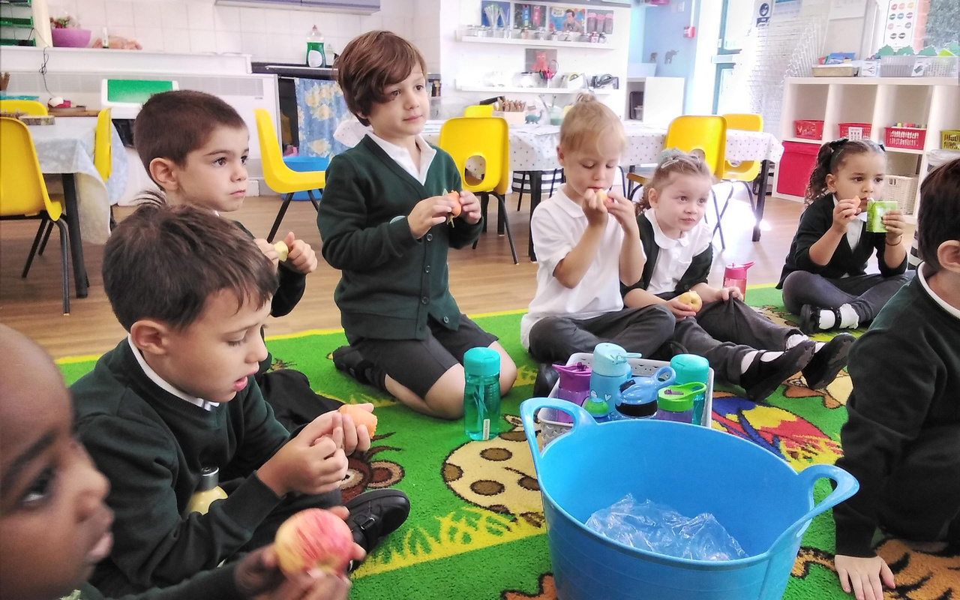
Our School day
Our day is split into 3 main parts.
1. Morning Session
2. After break session
3. Afternoon session
Children in the EYFS and Key Stage 1 have three break times each day.
In the morning and each afternoon, they will have 20 minutes and an hour for lunchtime.

Slide 11
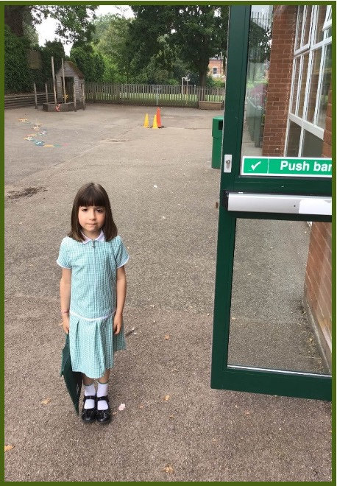
Our School day
When we arrive, we come into school by ourselves.

Slide 12
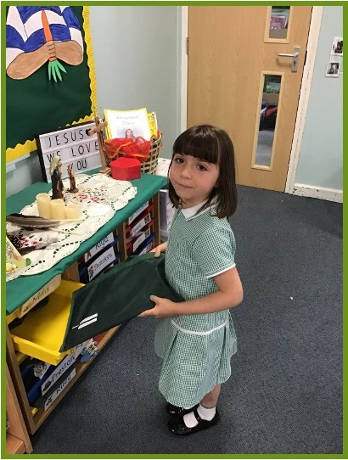
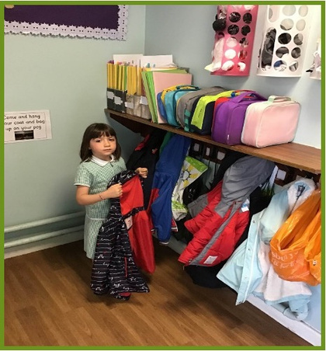
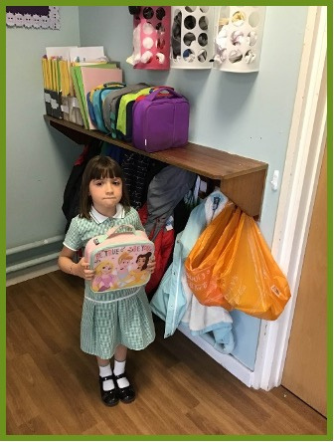
Our School day
When we come inside, we find our peg and hang up our coats.
Finally, we put away our lunchboxes if we have them.
Then we find our tray and put away our book bags.

Slide 13
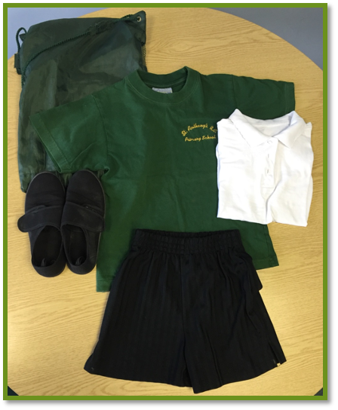
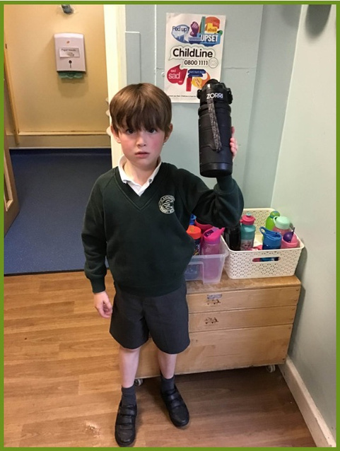
Our School day
Please make sure you send your child to school with a named water bottle with every day.
They also need a labelled PE kit in school every day, which should be brought in a drawstring bag.

Slide 14

Our School day
At lunchtime, the Reception class team will be on hand to help children as they settle in.
All children in Key Stage 1 are entitled to a free school meal.
All of our meals are cooked freshly each day in our on-site School Kitchen by Educaterers, who can provide meals for children with specific allergies and those who have a different diet due to cultural or religious observance.
Please make sure you have completed the Admission Form emailed to you in May to let us know about any dietary requirements your child may have.

Slide 15
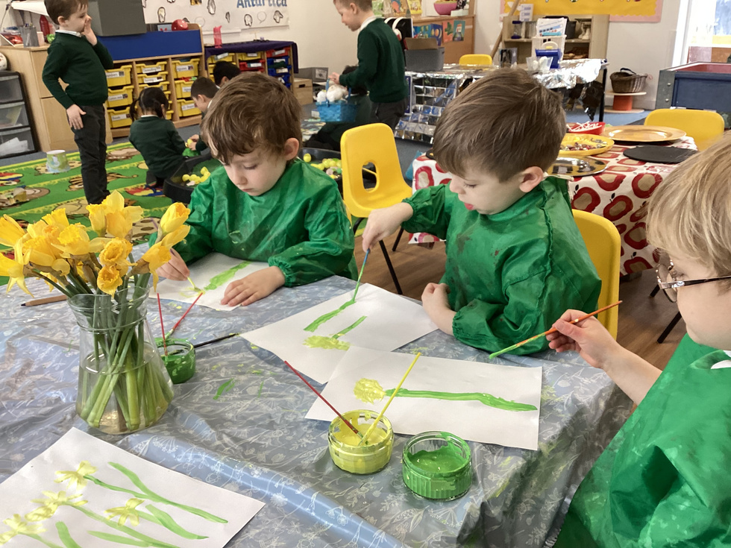
First days
Our first week in school will be half days. During that first week, the morning children should arrive at 9am and be collected from the classroom at 11:00am.
The afternoon group should arrive at 1.30pm and be collected at 3:30pm.
There will be fruit available for them to have an afternoon snack at break time if needed.
They will have a snack at morning break but should have their lunch at home.

Slide 16
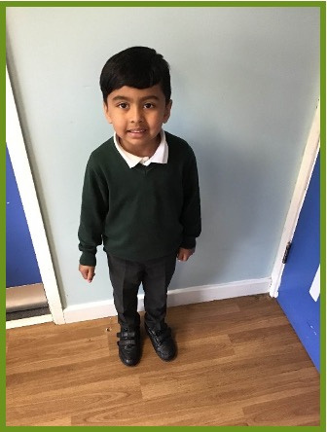
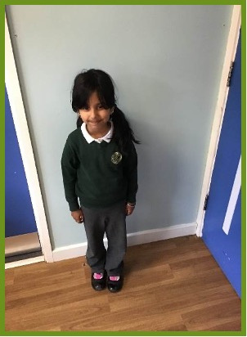
Winter Uniform
Grey skirt / trousers or pinafore
White polo top
Dark green cardigan or jumper
White/ black/ grey socks or grey tights
Black Velcro shoes
No laces/ boots/pumps or trainers
Long hair should be tied back all year round.

Slide 17
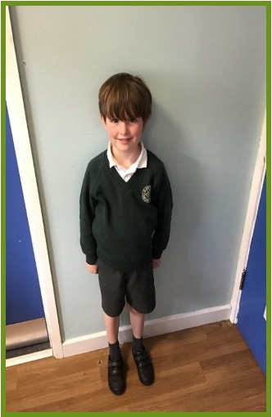
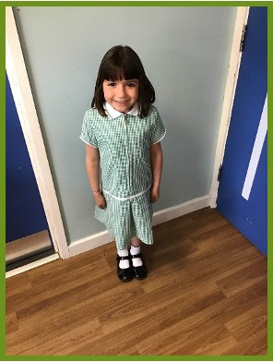
Summer Uniform
Grey Shorts
White polo shirt
Dark green jumper or cardigan
Black Velcro school shoes
No laces/boots/pumps or trainers please
White and green summer dress
White socks
Black Velcro shoes
No opened toed sandals or playsuits please.
Long hair should be tied back all year round.

Slide 18
What to do if your child is ill
If your child is ill, please register their absence on the Study Bugs app before 9am.
You should have received a link to follow to create an account with Study Bugs, please see us at the end if a problem.
If your child is sick or has an upset stomach, they must be off school for at least the next 48 hours after the last time they were poorly.
Please let us know at the earliest opportunity if you change your mobile telephone number or address, as we need to be able to contact you in an emergency situation or if your child is unwell.

Slide 19
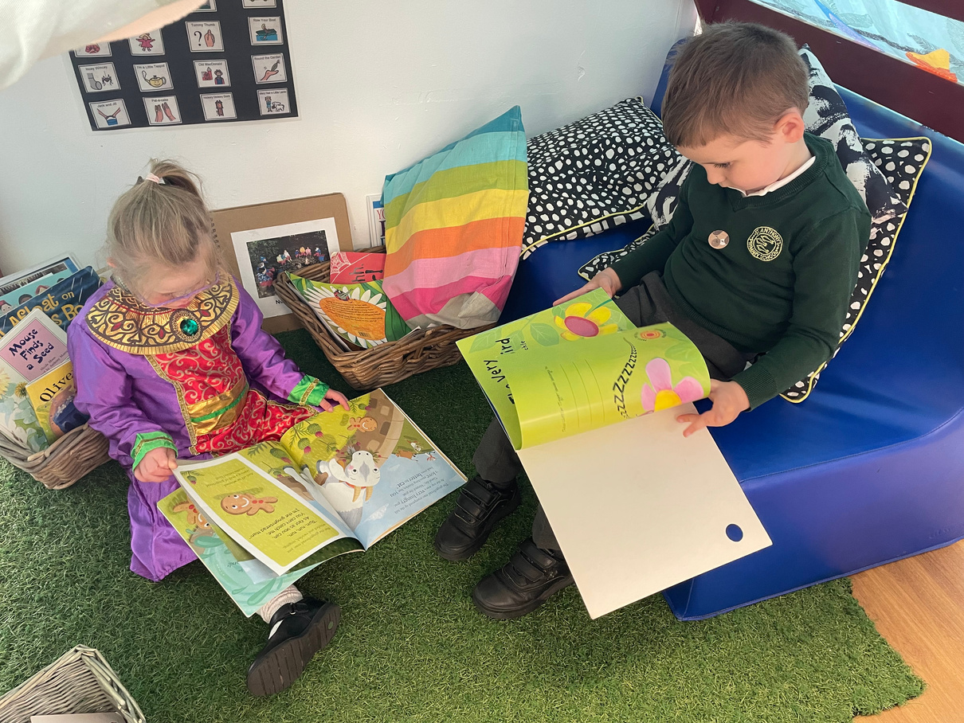
How to prepare your child at home
  Aim for your child to be as independent as possible.
-Can they dress themselves?
-Can they go to the toilet by themselves?
-Can they use cutlery to cut and eat their food with?
  Share a book with your child every night. Let them choose, perhaps visit the local library. Talk about the story and the pictures together.
  Practise sharing and taking turns eg through turn taking games such as snakes and ladders, snap etc.

Slide 20

Wrap around care
At St Anthony's, we are proud to be able to offer our families onsite wrap around care 'Early Birds and Night Owls' which is run by Mary Moran.
We understand that wrap around care is a necessity for many working parents , however places in the Early Birds and Night Owls clubs are limited and offered on a first come, first serve basis. If you think you will need to use this service from September, we can provide you with Mary’s contact details.

Slide 21

Wrap around care
Those with older siblings in school will also know that Mr Bromley, our PE Teacher, also hosts before and after school sports clubs, however these are not open to Reception children until after the October Break during the Autumn Term.
Further information on these clubs will be sent out by Mr Bromley later in the Autumn.

Slide 22
Dates for your diaries
Induction Morning – Wednesday 10th July 2024 – 09:30am – 10:30am - All children in together. Parents to stay with their child (please no siblings)
Storytime- Wednesday 17th July 2024 2.00pm-2.30pm
Home visits – Tuesday 3rd September 2023 until Friday 6th September 2023
- Please make sure you have booked a home visit with Miss Larkin before you leave this evening.
Starting School – Settling in. Half days begin on Monday 9th September 2023 until Friday 13th September 2023. Please make sure you have checked your child's group (morning or afternoon) before you leave - a reminder will be sent home.
Full days begin on Monday 16th September 2023 - 09:00am - 3:30pm

Slide 23


