Slide 1

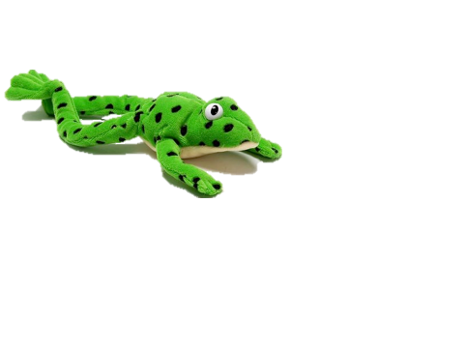

Parents meeting 2024

Slide 2
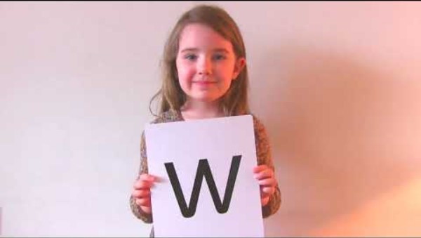

Slide 3
Speed Sounds Set 1
Notes:
These are the set 1 sounds that we began teaching your children when they joined us in September. They are all featured in the activity pack sent home and in the chart in their reading records.
- Children need to know sounds – not letter names – to read words.
- We pronounce the sounds clearly, using pure sounds (‘m’ not’ muh’, ’s’ not ‘suh’, etc.) so that your child will be able to blend the sounds together to make words more easily.

Slide 4

Name the pictures
Notes:
As it explained in the video, we introduce letter sounds to the children using a hook, a picture that looks like the letter sound to help them learn and remember them more easily. These are all represented on the speed sounds chart in their reading records and in the activity packs sent home at the beginning of the year.

Slide 5

Teaching letter formation
Notes:
Children use the picture mnemonic to learn to form letters correctly at the same time they learn to read each sound.
Each sound has a handwriting phrase e.g. down Maisie, and over the mountains.
When you practice at home, use the handwriting phrases in the activity packs with your child but avoid using them to read the sound.

Slide 6
What can I do?
1. Use pure sounds, not letter names
2. Teach the picture names
3. Practise reading sounds speedily -
‘review, review, review’
4. Use the handwriting phrases for writing only
Notes:
Show how to use ‘My Set 1 Speed Sounds Book 1’ or cards if you send these home.
You can purchase Set 1 flashcards or My Reading and Writing Kit ages 3-5 early sounds and blending to support your child with Set 1 sounds at home.

Slide 7


Sounds + blending = reading
+
Notes:
As we learn the letter sounds, we will use the sounds to read words by blending sounds together:
Alongside teaching children sounds, we teach them to blend sounds to read words e.g. s-a-t, sat.
We use Fred Talk to help children read.

Slide 8




Reading with Fred Talk
Notes:
We teach children to read words using Fred Talk to blend together the sounds they know e.g. m-a-t, mat.
When we do this, we say ‘Fred Talk, read the word’ and teach them to pinch their fingers as they say each sound. This helps them to ensure the sounds are in the right order to form the word.

Slide 9
Fred Talk routine
Say the word in sounds as Fred e.g. c-a-t.
Ask your child to repeat. Can they ‘jump-in’ with the whole word?
Say the word in sounds followed by the whole word e.g. c-a-t, cat
Ask your child to repeat
Notes:
Fred Talk follows a consistent routine:
Say the word in sounds as Fred e.g. c-a-t. Ask children to repeat. Pause to allow children to ‘jump-in’ with the whole word.
Say the word in sounds followed by the whole word e.g. c-a-t, cat. Ask children to repeat.

Slide 10
Fred games and Fred talk throughout the day
l
-u
?
Shall we have some
What would you like to
Let’s put on your
-ch
-n
-ay
-l
p
?
-oa
-t
c
.
Notes:
You can help at home by using Fred Talk throughout the day to help your child practise blending sounds together.
Fred Talk words at the end of the sentence and keep the words short and simple.

Slide 11

‘Three with me, four at home’
Accuracy
Fluency
Comprehension
Read and enjoy at home
Notes:
In our school, children read each Read Write Inc. Storybook three times in class with their partner and teacher.
Re-reading the same book helps children to become confident readers. Each time they re-read, they build their fluency/speed and comprehension.
They love reading and want to read because they can read all of the words in the Storybook.
We set a focus for each re-read in school.
The first read focuses on reading every word accurately.
The second on reading the story more quickly.
The third read on using expression and intonation in their voices to read the story as a story-teller.
Your child will then bring a book home that matches their phonic stage to read and enjoy with you at home.
Please avoid saying, “This book is too easy for you!” but instead say “I love how well you can read this book!”
They are meant to be able to read all of the words as the book is at the correct level. Encourage them to share their enjoyment of the story with you and read it in their storyteller voice – again and again.

Slide 12


‘Special Friends’, ‘Fred Talk’, read the word
Notes:
Children will be able to read all of the words in the Storybook.
If they hesitate, remind them to read the word using ‘Special Friends, Fred Talk, read the word’.
For example, this means they spot the ‘sh’, then Fred Talk and blend to read the word e.g. sh, sh-i-p, ship.

Slide 13


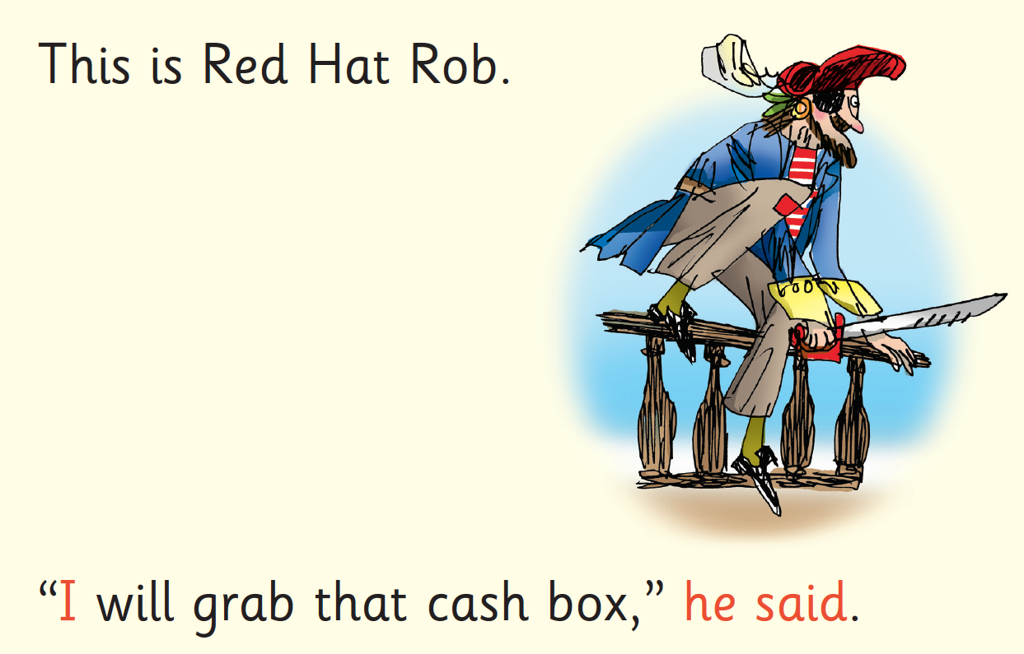
Red Words
Notes:
Some words are ‘tricky’ because they contain letters that don’t match the sounds the child has been taught.
For example, ‘said’ has ‘ai’ making an ‘e’ sound.
We teach these common exception words as Red words.
In the early Storybooks, these words are printed in red text.
Remind your child to stop and think about Red words and tell them the word if needed.

Slide 14




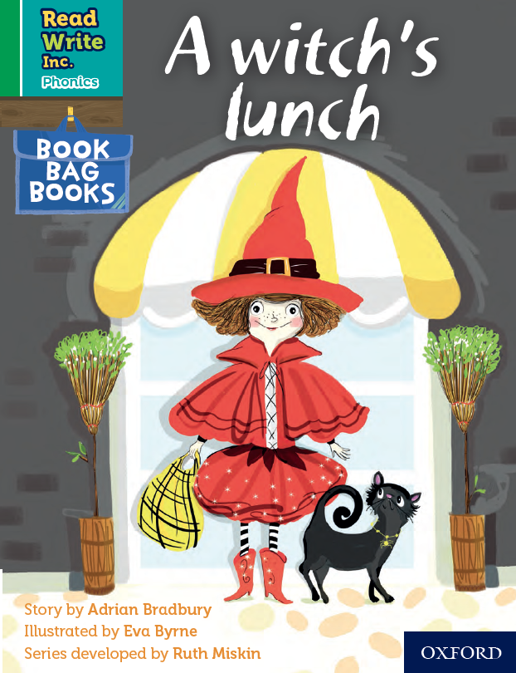
Book Bag Books
Extra reading practice at home
Uniquely matched to the Read Write Inc. Phonics Storybooks.
Reinforce children's learning of phonics at the appropriate level.
Helps to make even faster progress in reading.
Notes:
We also use Book Bag Books especially for home reading. They are closely matched to the books children read in school so provide practice of the same sounds – extra practice at the right level for your child. Please don’t be alarmed or worried if they cannot fluently read this book. We want to make sure they enjoy reading so that they want to read. The more they read, the faster progress they will make.

Slide 15
What can you do?
Listen to your child read the same Storybook again and again
Encourage them to use ’Special Friends’, ‘Fred Talk’, ‘read the word’
Discuss the story and encourage their storyteller voice.

Slide 16





Repeated readings, ‘Again! Again!’
Children are wired to thrive on repetition
Notes:
Stories provide a wealth of language we don’t use in everyday talk.
The more stories, poems and nursery rhymes children know well, the more easily they will be able to understand what they read, when they can read.
Children thrive on repetition, the more they hear or do something, the more they learn.

Slide 17
10 things your child learns when you read aloud stories and poems every day
Sustain attention
Appreciate rhythm and rhyme
Build pictures in their minds from the words on the page
Understand humour and irony
Use new words and phrases in different contexts - and later in writing
Learn new vocabulary and knowledge of the world
Think about characters’ feelings and use appropriate voices
Follow a plot with all its twists and turns
Understand suspense and predict what’s about to happen next
Link sentences and ideas from one passage to the next
Notes:
Look at all these things you child will learn when you read aloud stories and poems, - without any teaching!

Slide 18
Top Tips - Storytime
Make it a special occasion
Make it a special quiet time
Show curiosity
Read story once without stopping
Chat about the story
Avoid testing with questions
Link to other stories and experiences
Read favourites over and over again
Use different voices
Love the book
Notes:
Here are our ten top tips for Storytime at home.
Make it a treat – introduce each new book with excitement.
Make it a special quiet time – cuddle up!
Show curiosity in what you’re going to read.
Read story once without stopping so they can enjoy the whole story. . If you think your child might not understand something say something like ‘Oh I think what’s happening here is that…”
Chat about the story e.g. I wonder why he did that? Oh no, I hope she’s not going to…
Avoid asking questions to test what they remember.
Link to other stories and experiences you have shared e.g. this reminds me of…
Read favourites over and over again – encourage your child to join with the bits they know. Avoid saying ‘not that story again!’
Use different voices – be enthusiastic!
Love the book – read with enjoyment.
I will give you a handout with these tips when you leave today.

Slide 19
Online resources available
Ruth Miskin Parents’ Page:
http://www.ruthmiskin.com/en/parents/
Ruth Miskin Facebook:
https://www.facebook.com/miskin.education
Free e-books for home reading:
http://www.oxfordowl.co.uk/Reading/

Slide 20
The more that you read, the more things you will know. The more that you learn, the more places you’ll go!
Dr. Seuss
Notes:
In the words of Dr Seuss…read quote.
Good readers do well in school – and in life.
By listening to your child read, you are making sure they have the opportunity to practise and become a good reader quickly.
Remember that all parents have the power to change outcomes for their children.

Slide 21
Any other questions?
Q&A

