Slide 1


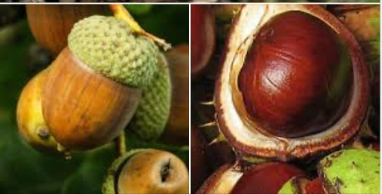

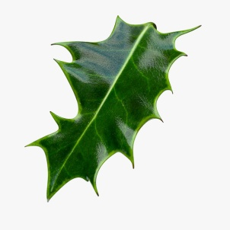
Nursery Autumn Topic Plan- Autumn celebrations
Key Terms
Literacy Listen to & join in with stories with a repeated refrain e.g. The little Red Hen, Model the correct way to hold a book and turn the pages. Provide “reading” opportunities by displaying non-fiction books and stories around the classroom e.g. “Farmer Duck” by a model farmyard. Encourage children to look for their name when self-registering or hanging up their jumper. Provide exciting mark-making opportunities e.g. Water and paintbrushes or a tray of flour. Encourage mark-making for a purpose such as writing a shopping list in the home-corner.
Seasons | The year has 4 parts, spring, summer, autumn & winter, with different weather which affects living things.
Farm | The place where a farmer works to grow crops and livestock.
Leaves | The flat, green living part of a plant; some change colour and fall off in the autumn.
Acorn & Conker | These are seeds that fall from an oak tree and a horse chestnut tree.
Evergreen tree | Unlike a deciduous tree, this has green leaves all year round, for example a holly tree.
Hibernation | Some creatures get ready in the autumn to sleep, or hibernate, all winter.
UoW Talk about their family & key events e.g. birthdays Invite parents to talk about St Nicholas day or Diwali, and to decorate hands with mendhi. Look for signs of autumn in the school grounds Make a “bonfire” or a bug hotel in forest school Observe the changes in weather and the clothes we wear. Look after plants and plant bulbs Visit the post-office and post a letter to Santa
Mathematics Through sand and water play, develop the language of quantity (full, empty) and size e.g. filling containers, making different sized sand castles Encourage rote counting, singing number rhymes e.g. “5 little leaves” Show interest in shapes by sustained construction e.g. Building a tower or a farm using bricks or duplo Use the visual timetable to allow anticipation of snack time or home time Use of sand-timers to help children take turns e.g.”In a minute you can play with the car”
Go on leaf walk-what different shapes and sizes can you see?

Slide 2




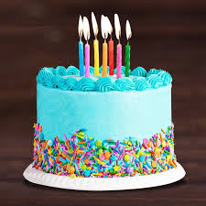
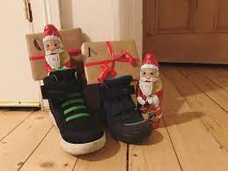
Nursery Autumn Topic Plan- Autumn celebrations
P.D Encourage large motor skill development when running & balancing or using a large paintbrush & water outside. Encourage fine motor skill development e.g. when picking up small objects such as threading beads or completing a puzzle Develop mark-making skills by providing varied opportunities such as mark-making in flour or gloop Talk about good hygiene ; teach them to wash hands after using the toilet and before eating
Key Terms
Celebration | When people do something enjoyable and different because it is a special day
Harvest festival | A celebration of the food that has grown and been harvested/ gathered
Diwali | The Indian festival of light, celebrating the triumph of good over evil.
Advent | The Christian time of getting ready for the birth of Jesus
Christmas | The celebration of Jesus’ birthday
C&L Re-tell stories through small world play Follow simple instructions Learn new vocabulary such as leaf, stem, vein. Answer simple questions Talk about what they are doing and ask questions e.g. What’s this? Where is that?
EA&D Listen to nursery rhymes and sometimes join in with actions and/ or words Draw lines and circles when mark-making Squash and squeeze play dough; some times use tools to shape it Enjoy taking on familiar roles in the home-corner such as being a mum or dad cooking tea or looking after the baby.
PSED Learn to follow the nursery routines talk about and model how to ask to play or to take turns Talk about and model rules to keep us safe and happy e.g. Having kind hands and saying kind words Develop attention skills by listening to a story or singing nursery rhymes in a group
What special days do you celebrate with your Family?

