Slide 1
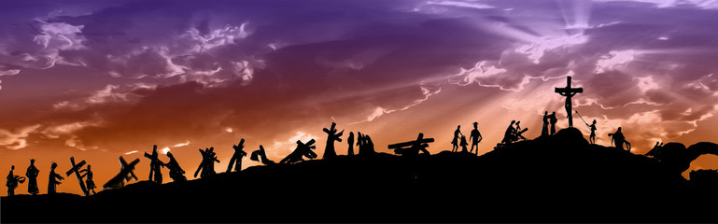
The way of the Cross
Photographs taken by Father Noel in our Parish Church, St. Peter Apostle
Take a moment to look at each image before you read the passages, say the prayers and reflect for a moment before moving on to the next station.

Slide 2

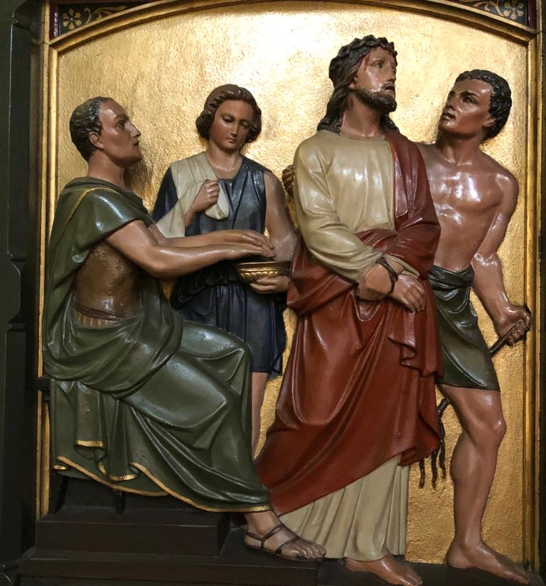
I
Jesus is condemned to death
Jesus was accused of many crimes he didn’t commit. He didn’t defend himself. He knew he needed to die for our sins.
Prayer: Jesus, I often get defensive when I know I did something wrong. Help me be honest. I also don’t want to be a tattletale or accuse others of doing wrong.

Slide 3
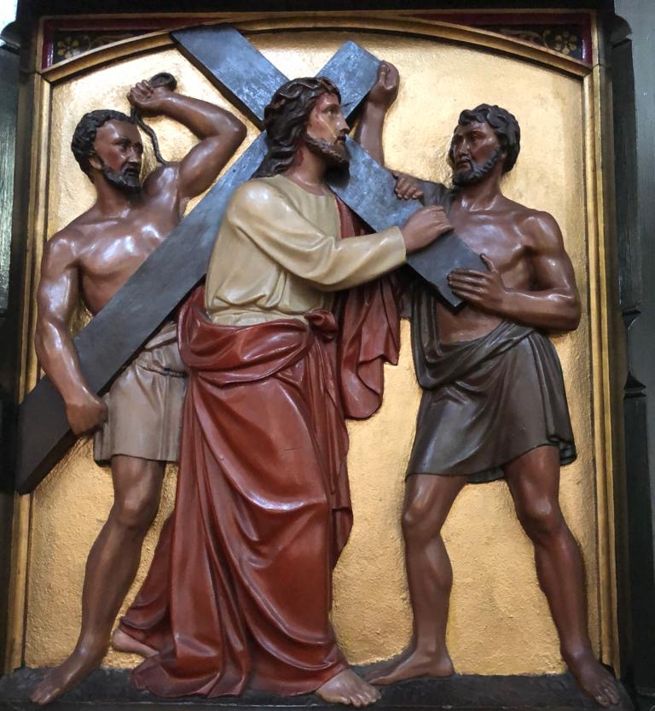
II
Jesus is laden with His cross
The cross was big and heavy. It was hard for Jesus to carry it. Jesus carried the heavy cross without complaining once.
Prayer: Sometimes schoolwork or jobs at home are hard for me and I complain. Jesus, please help me not to complain. I want to keep trying, even when I find something hard.

Slide 4
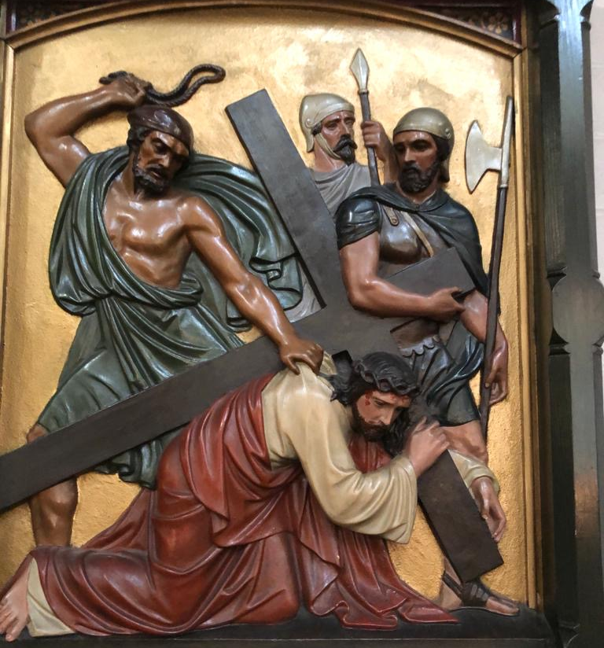
III
Jesus falls the first time
Jesus was already badly wounded when he fell the first time. It must have hurt very much. Jesus got up and kept on going.
Prayer: When we don’t succeed in school or when we lose a sports game, it can make us feel defeated. Jesus was hurt but never defeated. Jesus, I want your attitude of hope and victory even if I am not succeeding.

Slide 5
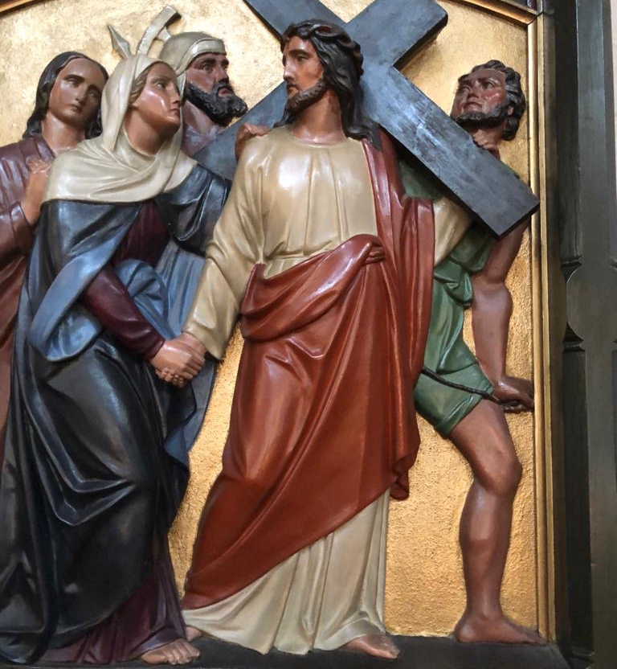
IV
Jesus meets his mother
Jesus knew that his mother was sad to see him suffering so much. But he was so happy she came to him. Mary loved Jesus very much.
Prayer: Our parents love us very much, and sometimes we don’t let them hug us and care for us because we are mad or sad or don’t want them to see us in trouble. Jesus, I thank you for my parents and their love for me.

Slide 6
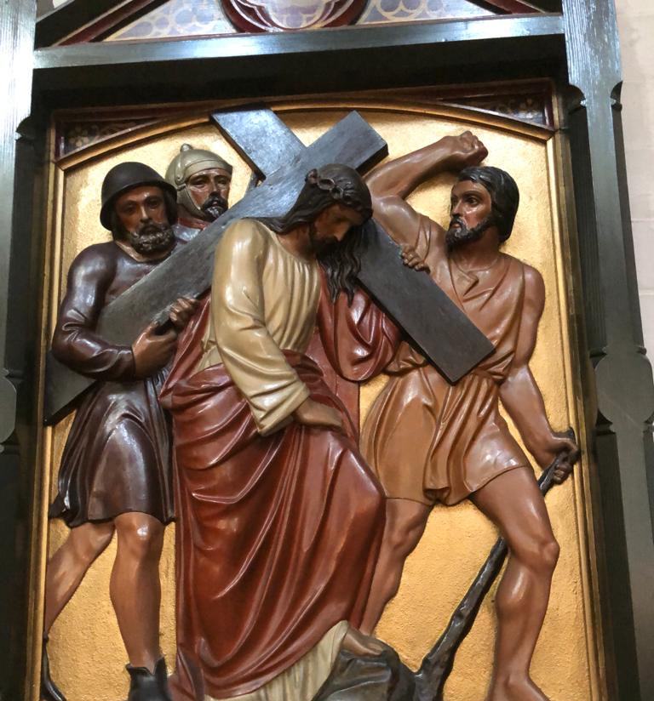
V
Simon of Cyrene helps Jesus to carry His cross
Simon didn’t come to help Jesus but to see what was going on. Then he was ordered by the soldiers to carry the cross, because Jesus was having such a hard time.
Prayer: Sometimes I don’t want to help my friends or brothers and sisters or parents when I am told to. Jesus, help me know that when I do help others, it is like helping you. I want to be kind and helpful.

Slide 7
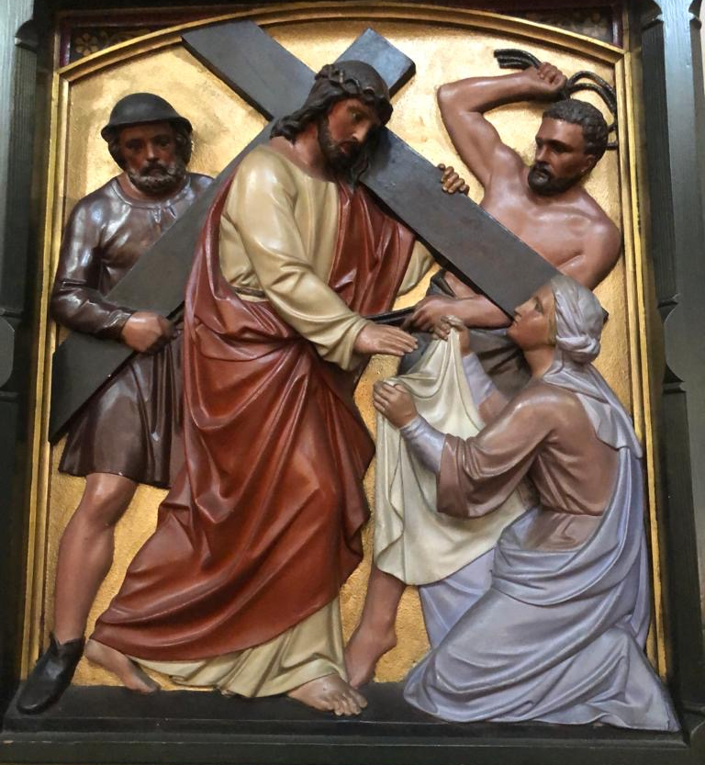
VI
St. Veronica wipes the face of Jesus
Veronica loved Jesus very much. When she stepped out to wipe his face, she risked getting in big trouble from the soldiers. Her love and kindness overcame her fear.
Prayer: Jesus, I want to love you like Veronica. Help me to be brave and love others who are unpopular.

Slide 8
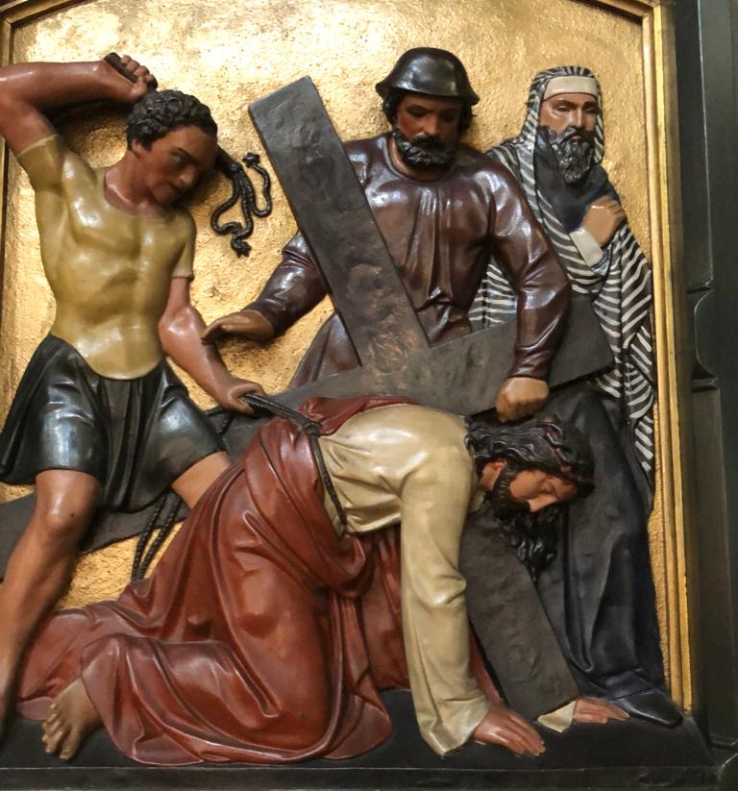
VII
Jesus falls the second time
Jesus fell again because he was so weak and tired from all his wounds. He still didn’t give up. He got back up and continued on.
Prayer: Think of something that makes you feel weak, something that is hard for you to do. Ask Jesus to help you with this.

Slide 9
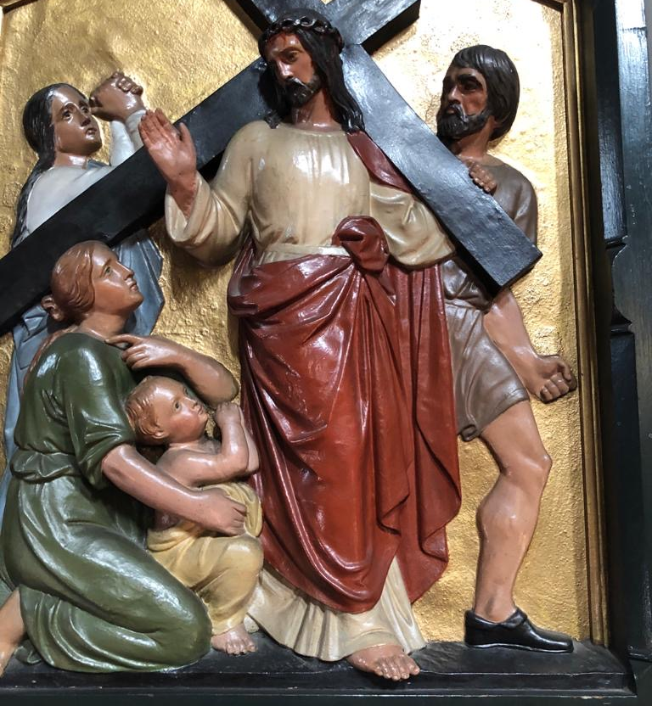
VIII
Jesus consoles the women of Jerusalem
A lot of people were against Jesus, but a lot of people followed him. They were his faithful friends.
Prayer: Help me to be a faithful friend. When my friends are going through a hard time or are being made fun of, I want to help them and be a true friend.

Slide 10
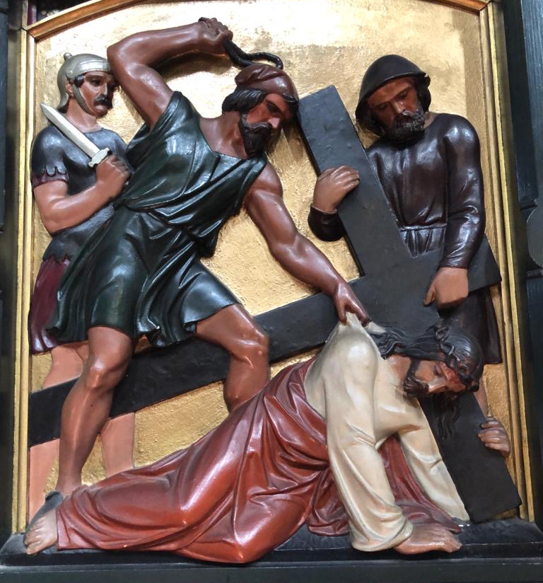
IX
Jesus falls a third time
It’s unbelievable that Jesus fell again and the soldiers didn’t help him. They only yelled louder for him to get up and continue on. Jesus didn’t get mad at them; he forgave them.
Prayer: Sometimes people say or do hurtful things to us or don’t help us when we need them. Jesus, help me to forgive everyone like you did. Help me not to get angry or hold a grudge against someone who has hurt me.

Slide 11
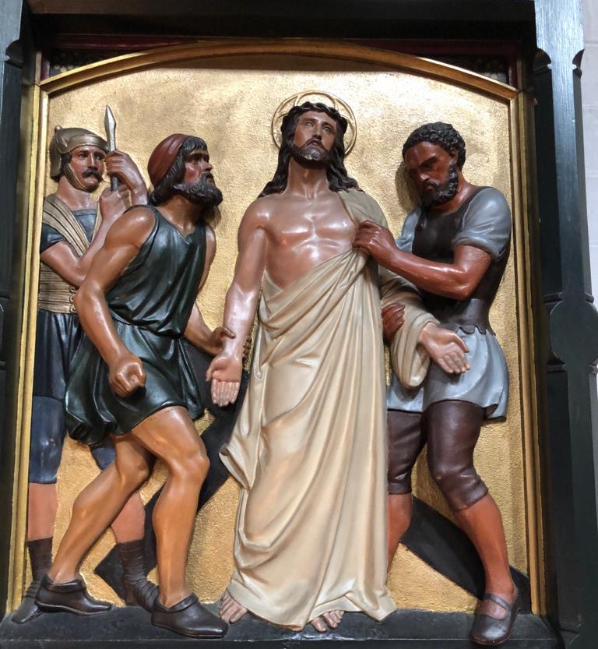
X
Jesus’ clothes are taken away
To be without clothes in front of everyone is a humiliating thing. Jesus wasn’t ashamed because he knew his Father in heaven loved him and everyone who was there.
Prayer: Jesus, I want to know how much you and the Father love me, so I will never be embarrassed or ashamed.

Slide 12
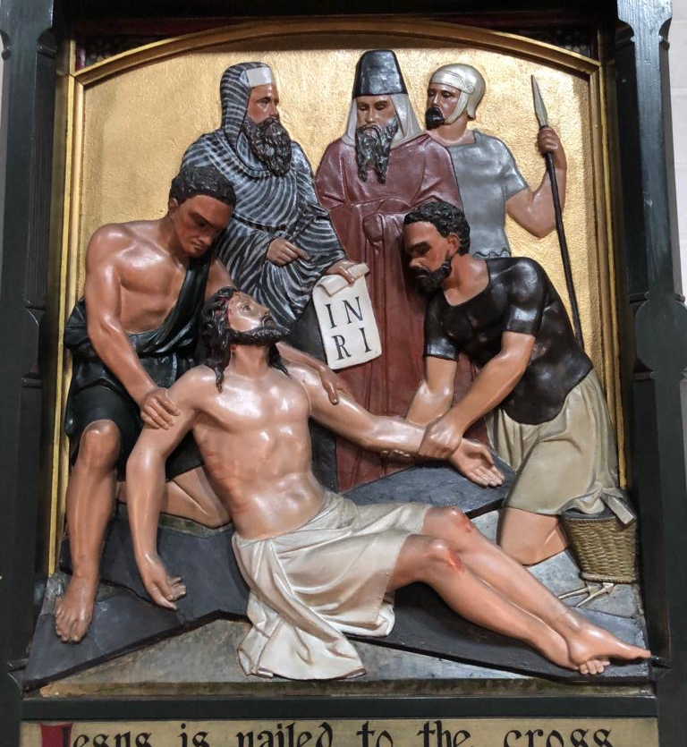
XI
Jesus is nailed to the cross
The soldiers drove nails through Jesus ’ hands and feet. They lifted up the cross and put it in place. Jesus was in a lot of pain.
Prayer: Many people suffer pain every day from being sick, hungry, poor, and because of war or natural disasters. Jesus, please comfort everyone who is in pain today.

Slide 13
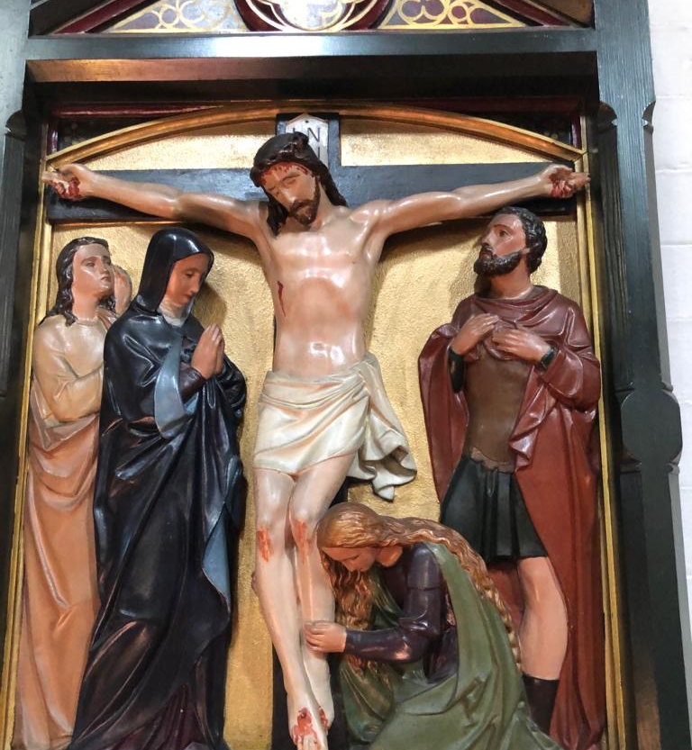
XII
Jesus dies on the cross
When Jesus died, the sky got dark and the ground started to shake. This made some people very scared. They saw that Jesus was innocent and that they had made a big mistake.
Prayer: Jesus, help me to admit when I make mistakes. Help me to say I’m sorry. Thank you for always forgiving me. I love you, and I want to do the right thing.

Slide 14
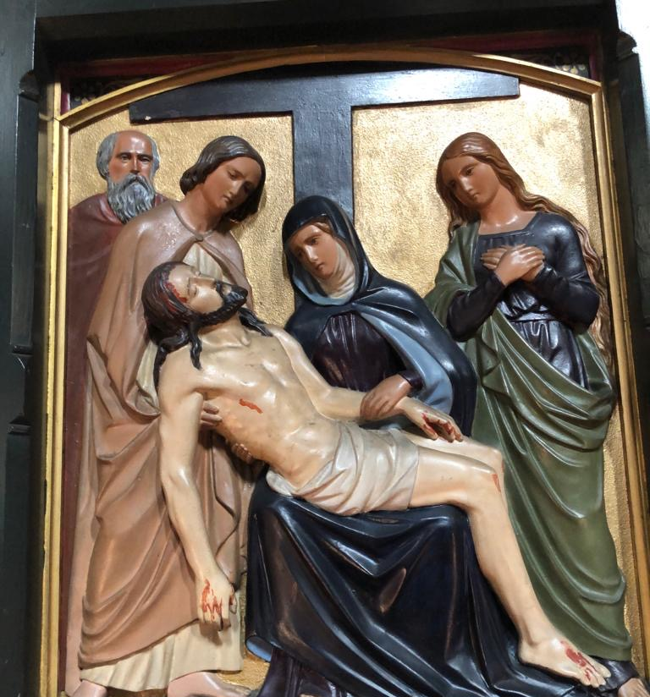
XIII
The body of Jesus is taken down from the cross
Joseph of Arimathea gave Jesus his own burial cave because Jesus didn’t have a place to be buried. Joseph was another one of Jesus’ friends who took a risk to help him.
Prayer: Sometimes it is risky to step out and help people who are in need. Jesus, I want to be a risk-taker and help others. Give me love and courage.

Slide 15
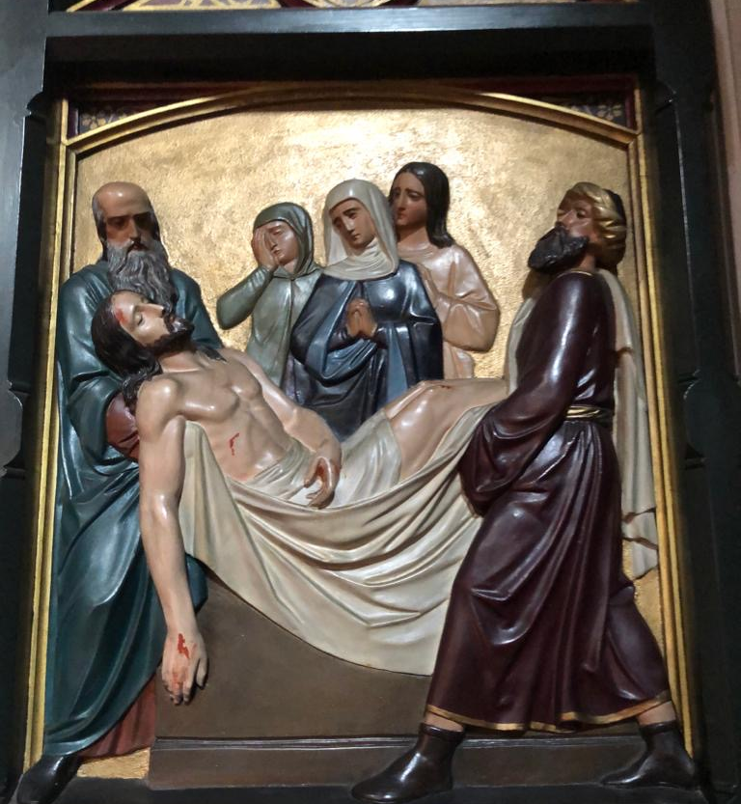
XIIII
Jesus is laid in the tomb
Even when things look very difficult and sad, there is always hope that God can bring new life.
Prayer: Jesus, I believe that you died and rose from the dead so that I could have new life. Thank you!

Slide 16
The Lord’s Prayer
Our Father, Who art in heaven,
Hallowed be Thy Name.
Thy Kingdom come.
Thy Will be done,
on earth as it is in Heaven.
Give us this day our daily bread.
And forgive us our trespasses,
as we forgive those who trespass against us.
And lead us not into temptation,
but deliver us from evil.
Amen.

