Slide 1
L.O. To understand that Lent is a time of preparation and change
- To know that Lent is a special season when Christians pray for forgiveness and try to change to become more like Jesus
- To understand the meaning associated with receiving the ashes on Ash Wednesday
- To explore some of the traditional customs and practices of the Season of Lent.

Slide 2
What is Lent?
Thinking about the scripture we have just shared and all the learning you have done throughout your lives at St. Anthony’s, talk about this and see if you can write down anything you know to answer this question.
What is Lent?

Slide 3

What is Lent?
Lent is a period of time when Christians think about things that need to change in their lives to become more like Jesus Christ.
Lent lasts how long? Why does it last this long?
It is a time of preparation for us to get ready for Easter, for us to fast, pray and give to help us to grow closer to God.

Slide 4
What is Lent?
Lent is often called the springtime of the Church – the word itself means lengthen and if you take care to notice, the whole world around you is growing and changing every day, just as we are during Lent.

Slide 5
How and why is Lent different?
Talk about your learning and the changes you see and have experienced around school and in Church and see if you can write down anything you know to answer this next question.
How and why is Lent different?

Slide 6
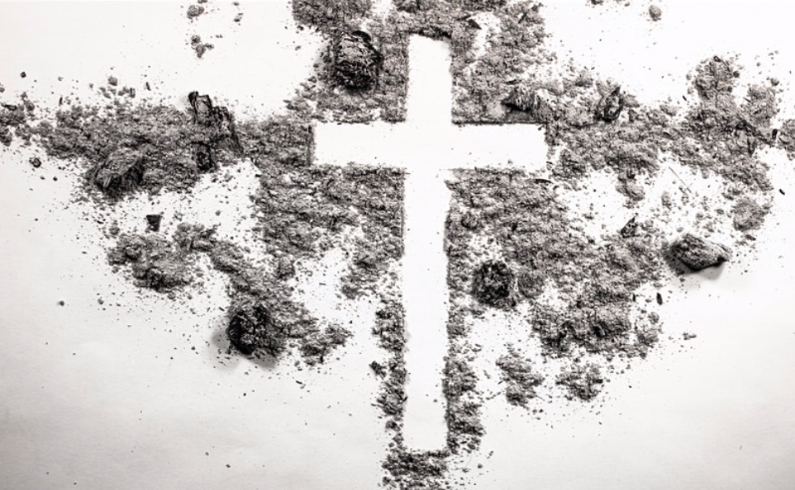
How and why is Lent different?
The dates when Lent begins and ends each year changes but it always begins seven Wednesdays before Easter Sunday.
The most important days we celebrate include;
Ash Wednesday
Every Friday
Palm Sunday – which begins Holy Week
Maundy Thursday – The Last Supper
Good Friday - Christ’s Passion and Death
Holy Saturday - the day before Easter

Slide 7
How and why is Lent different?
Liturgical colours change from Green for ordinary time, to Purple, because it reminds us of the pain and suffering of Jesus when he was crucified.
Purple is also a royal colour – why is this important?
The colour purple also symbolises that Lent is a time of preparation, can anyone remember another time of preparation when the colour purple is used?

Slide 8
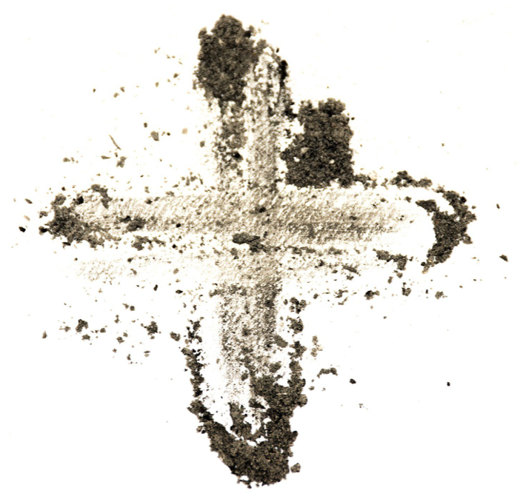
How and why is Lent different?
Another thing that is special and different about Lent is how it all begins.
On Ash Wednesday we attend Mass and receive ashes on our foreheads in the sign of the cross.
Any ideas what this shows?
It is a sign that we are seeking forgiveness for the things we have done wrong and want to change to be more like Jesus.
And of course, during the whole season of Lent, we do not say or sing the A*******.

Slide 9
How can we be more like Christ during Lent?
During the season of Lent, we focus on growth, change and transformation, just as Jesus did during those 40 days and nights in the wilderness – so how can we be more like him to help us grow and change this Lent?
Think about your Lenten promises and the scripture we shared at the beginning of our learning.
How can we be more like Christ
during Lent?

Slide 10
How can we be more like Christ during Lent?
We can become more like Jesus during Lent by being generous. How can we be more generous?
Live simply – fasting, saying no to the things we do not need.
Jesus is asking us to walk with him – How can you walk in his footsteps?

Slide 11
Explain the Pillars of Lent
A challenge. We have talked about all three of them already, but I wonder if you can think of anymore….
Explain the Pillars of Lent

Slide 12
Prayer
One thing we focus on during Lent is growing closer to God through prayer. Prayer is extremely important. Prayer bonds us with God. When we pray, we let God know we believe in Him and we learn to feel God’s love in our hearts.
There are many ways we can add more prayer to our daily prayer routine. It’s up to you to decide how much you pray and decide what you can add - you might decide to lead your family in Collective Worship – if you do, remember to use the grids on the Faith Leaders website page.

Slide 13

Fasting
Fasting is challenging for everyone. It is meant to be. Fasting means giving something up. More specifically something that you really enjoy. Then, there’s no way you can forget why you’re fasting.
That is exactly what you’re trying to achieve. Every time you want to have the thing you love you think of Lent and you think of Jesus. He will stay in your thoughts throughout Lent and remain in your minds and hearts long after Lent is over.

Slide 14
Almsgiving
As Christians, we recognise the presence of Jesus in everyone we see.
³⁴ “Then the King will say to those on his right, ‘Come, you who are blessed by my Father; take your inheritance, the kingdom prepared for you since the creation of the world. ³⁵ For I was hungry and you gave me something to eat, I was thirsty and you gave me something to drink, I was a stranger and you invited me in, ³⁶ I needed clothes and you clothed me, I was sick and you looked after me, I was in prison and you came to visit me.’
Matthew 25:34-36

Slide 15
Almsgiving
What was Jesus teaching us here?
What was God saying to us through this scripture passage?

Slide 16
Almsgiving
Like Advent, Lent is a period of time when Christians work to bring change into the world for those most in need. Remember we discussed the work of the Fr. Hudson’s Society and CAFOD.
What sort of change are they trying to bring about?
How might we help during the Season of Lent?

Slide 17
Almsgiving
1. Put a jar or container on the kitchen table and with your family select a charitable organisation and collect donation money Contribute a set amount of your pocket money, each week of Lent.
2. Give up buying junk food and contribute that money to the jar.
3. If you have younger brothers or sisters don’t get pocket money, let them contribute by decorating the jar or container.
4. Think of a charity to support and raise money for them through sponsored events, cake sales, bric a brac sales etc.
5. Donate any toys you don’t play with to charity
6. Have a spring clean of your clothes – can you donate any to charity?

Slide 18
Lord,
We thank You for all the gifts You have given us.
Please continue to guide us each and every day, remind us to wake up grateful and use Your Word to avoid the temptations we may face and instead pray to You.
To thank You
To love You
To hear from You Each and every day of our lives
Amen

